Slide 1
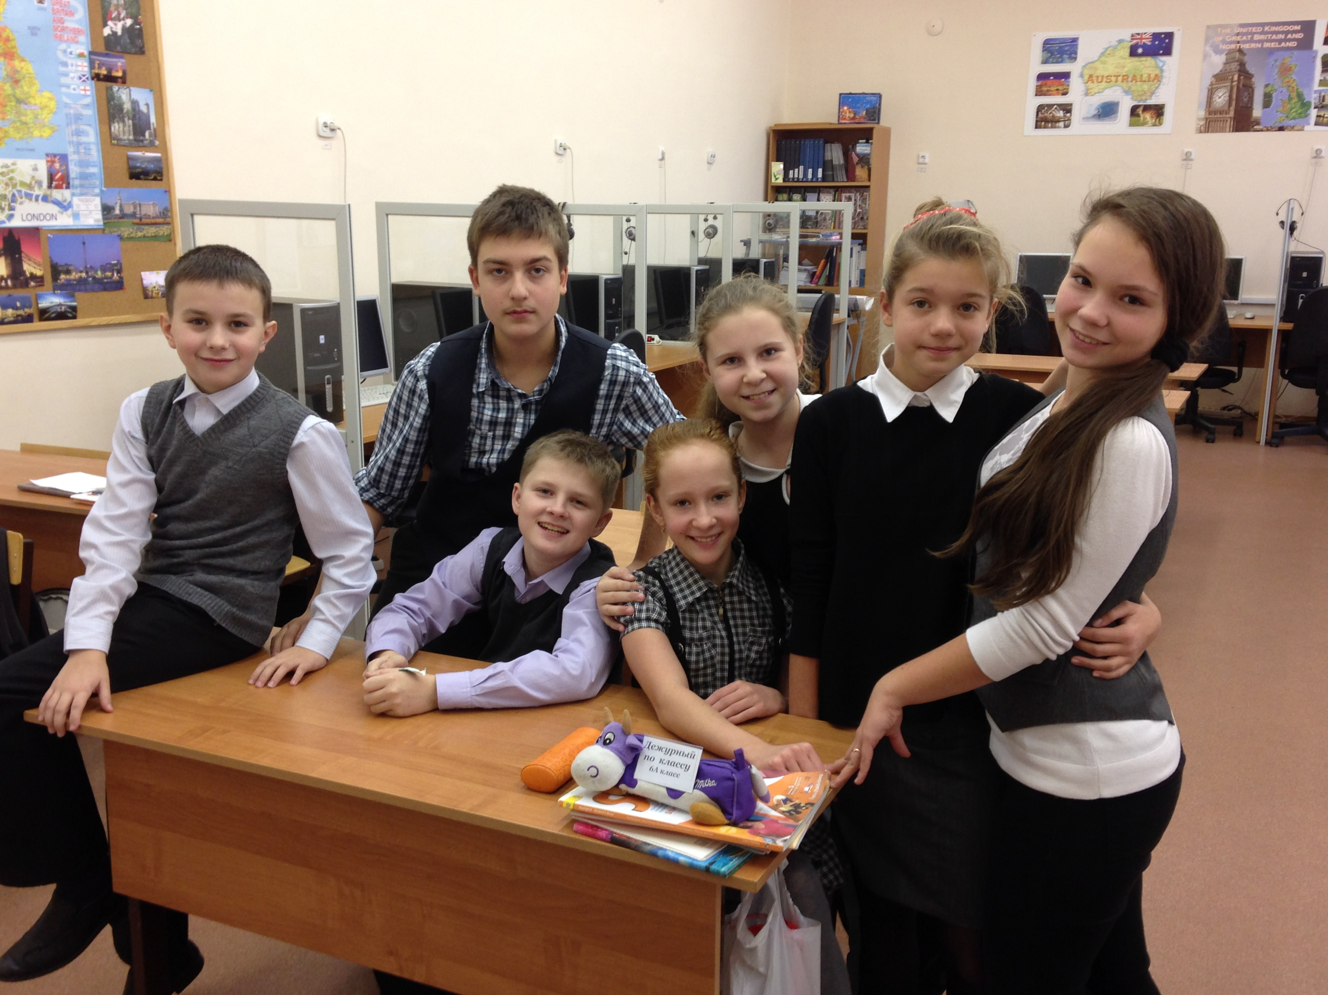
CLASS SURVEY
SAROV, RUSSIA

Slide 2



Hello, dear participants!
We are glad to have an opportunity to tell you about us and our environment
PART 1. INTRODUCING THE CLASS.
Name of teacher: Oxana Gorelova
Grade level: 6
Class favorites:
Music groups: "30 seconds to Mars", "Skillet"

Slide 3

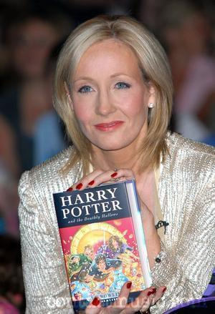
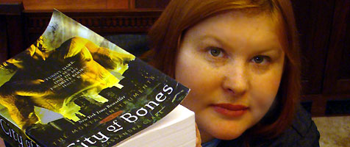
Authors: Cassandra Clare, Joanne Rowling, Jules Verne

Slide 4




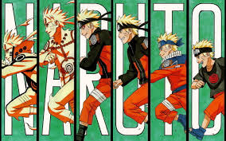
TV programs: series Naruto, Bleach, Fairy Tale, Comedy Club

Slide 5
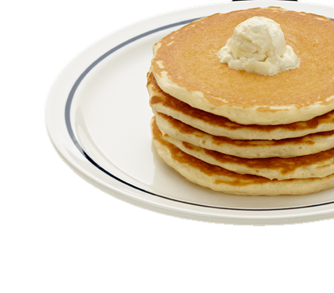
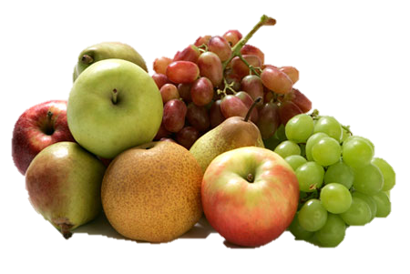
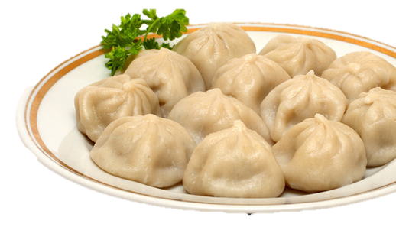
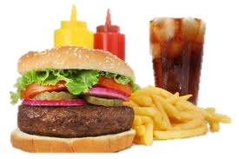
Foods: pancakes, pelmeny, fruit, fast food

Slide 6




School subjects: Maths, PE, English, Russian

Slide 7
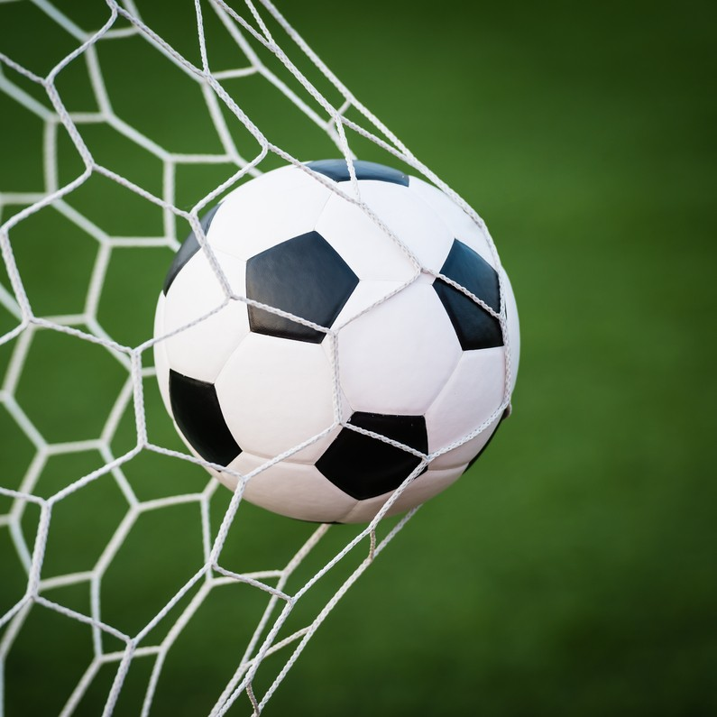
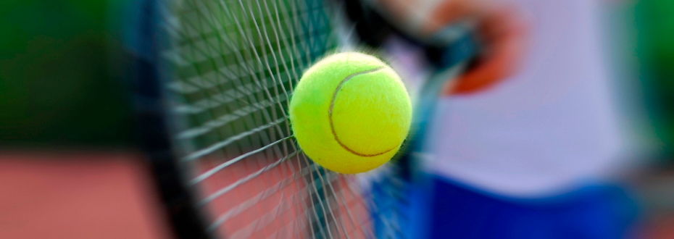
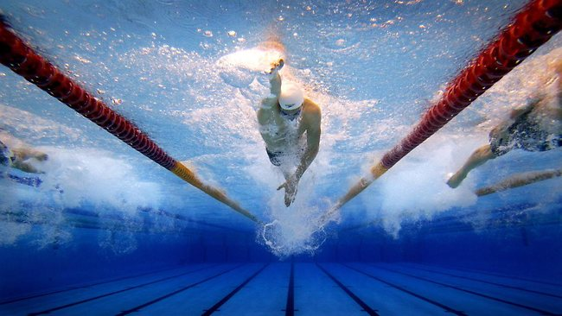
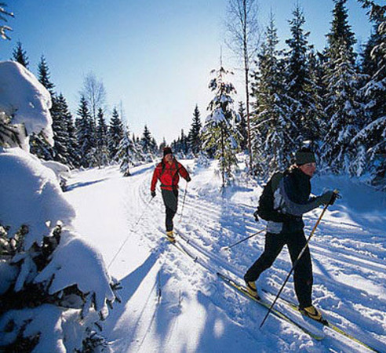
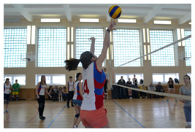
Sports: football, volleyball, swimming, skiing, tennis

Slide 8

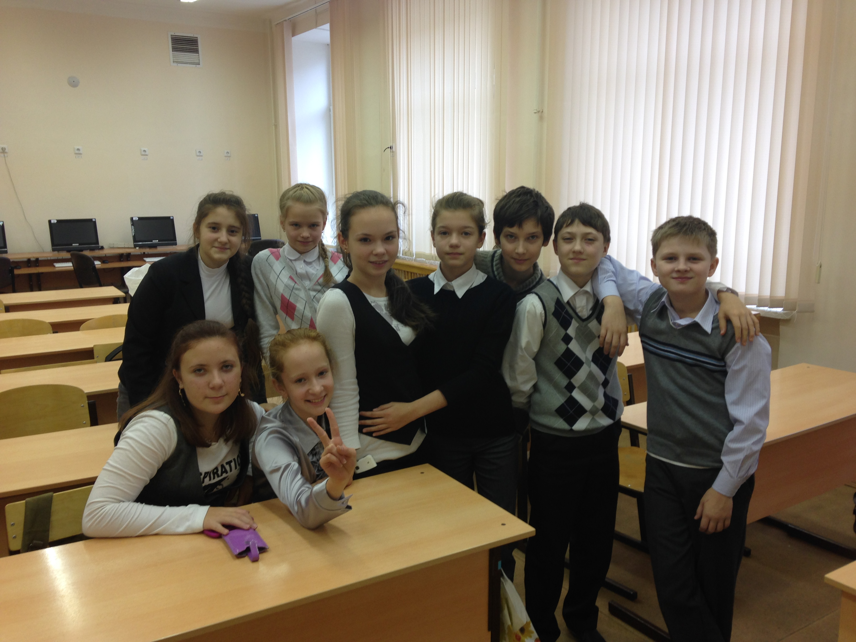

Video or computer games: Far Cry 3, Warcraft

Slide 9
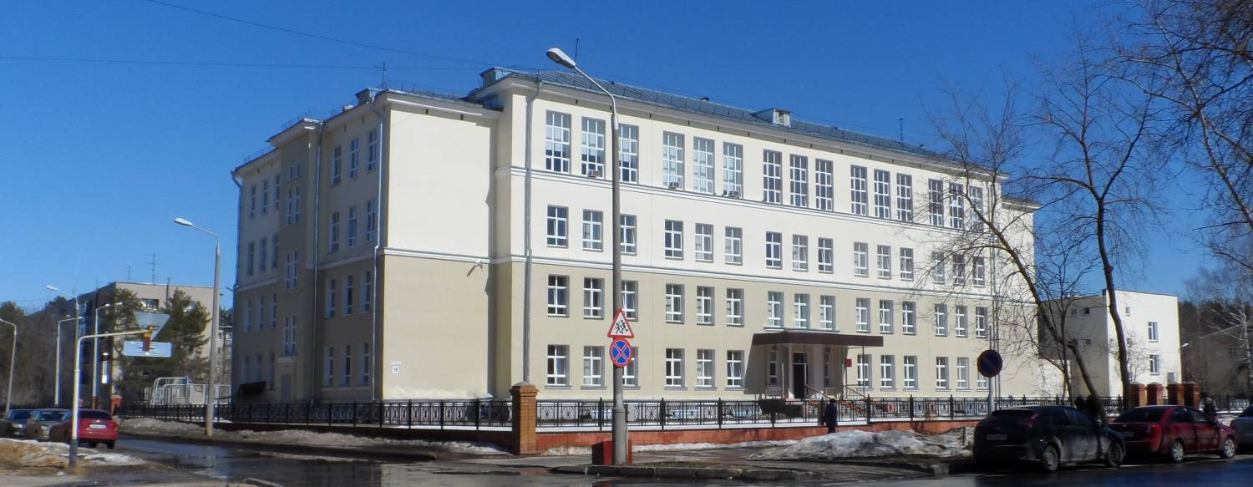
PART 2. INTRODUCING THE SCHOOL.
Dukhova street 16, Gimnazia 2
16 students in group, 550 students in school
4-storey building

Slide 10

PART 3. INTRODUCING THE COMMUNITY.

Slide 11
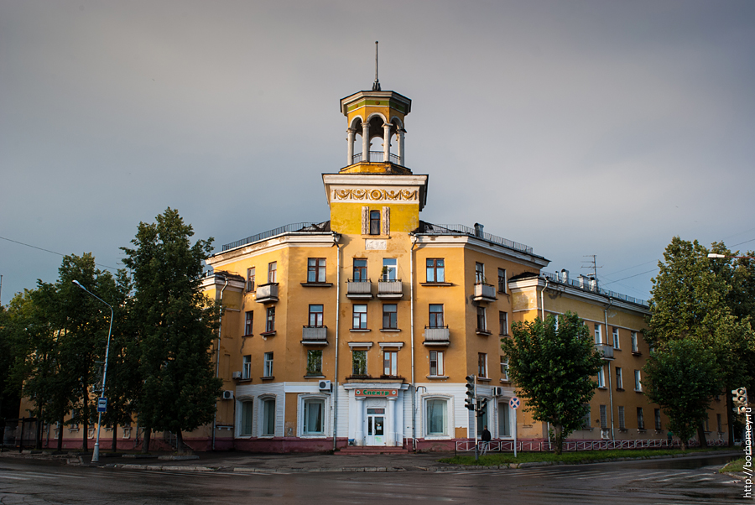
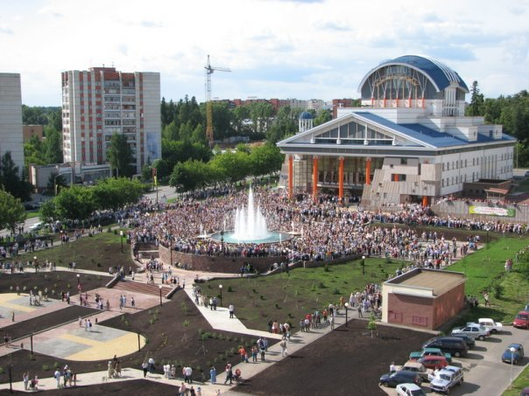
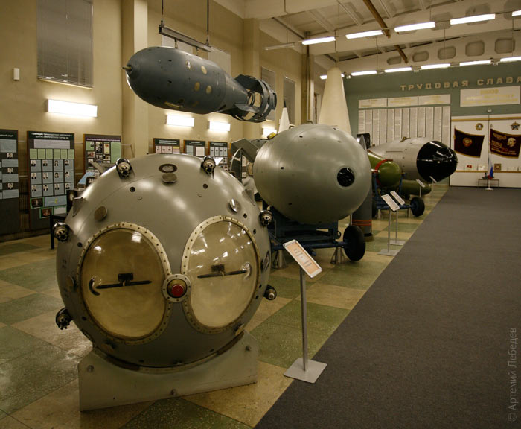
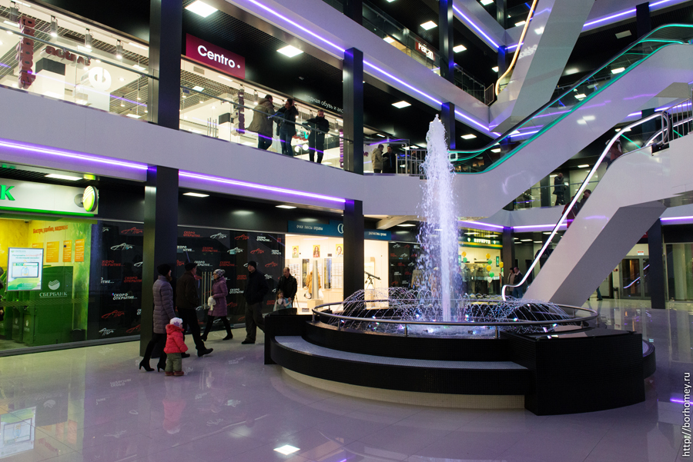

Slide 12
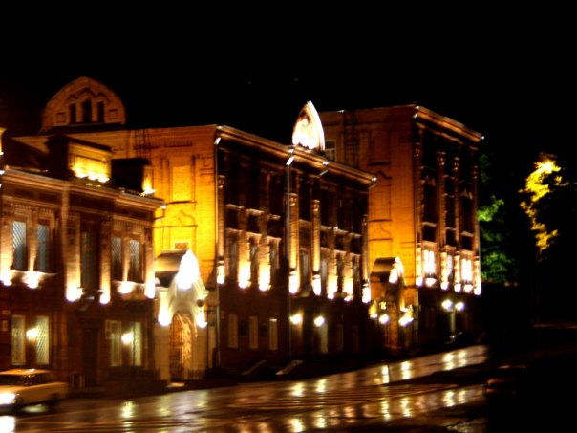
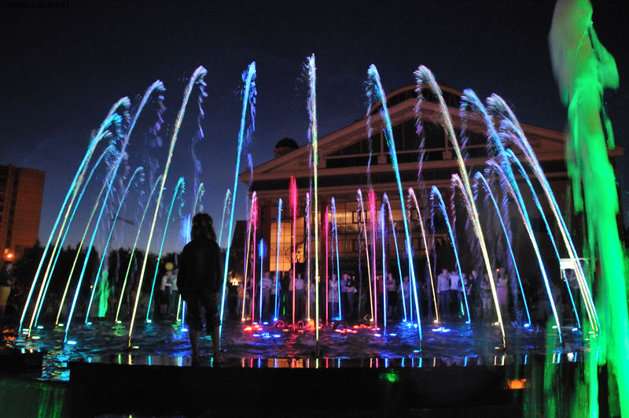
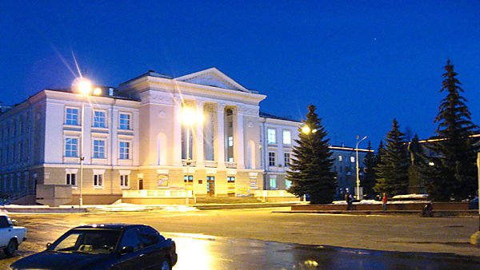

Slide 13
